Slide 1
Ch 3 : MORPHOLOGY AND FINITESTATE TRANSDUCERS

Slide 2
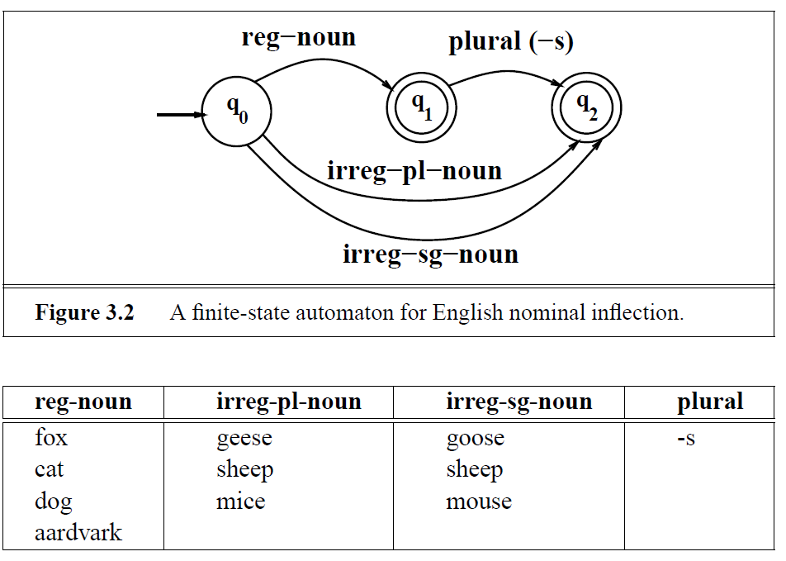
FINITE-STATE MORPHOLOGICAL PARSING

Slide 3
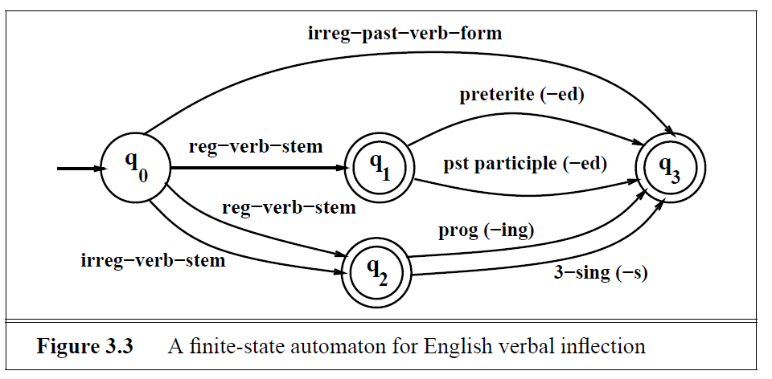
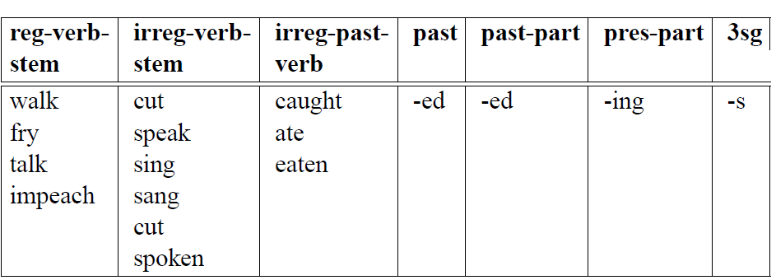

Slide 4
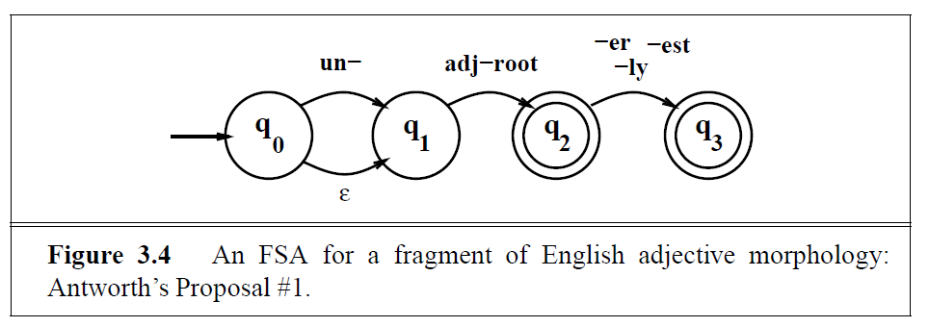

Slide 5
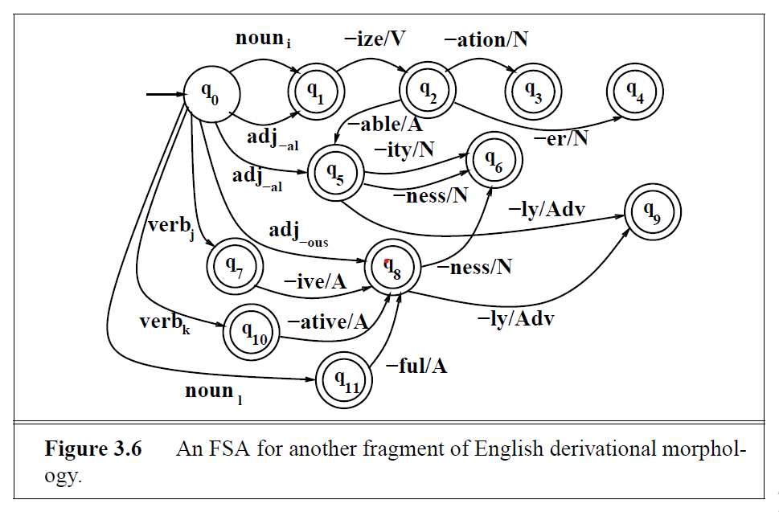

Slide 6

Morphological Parsing with Finite-State Transducers

Slide 7
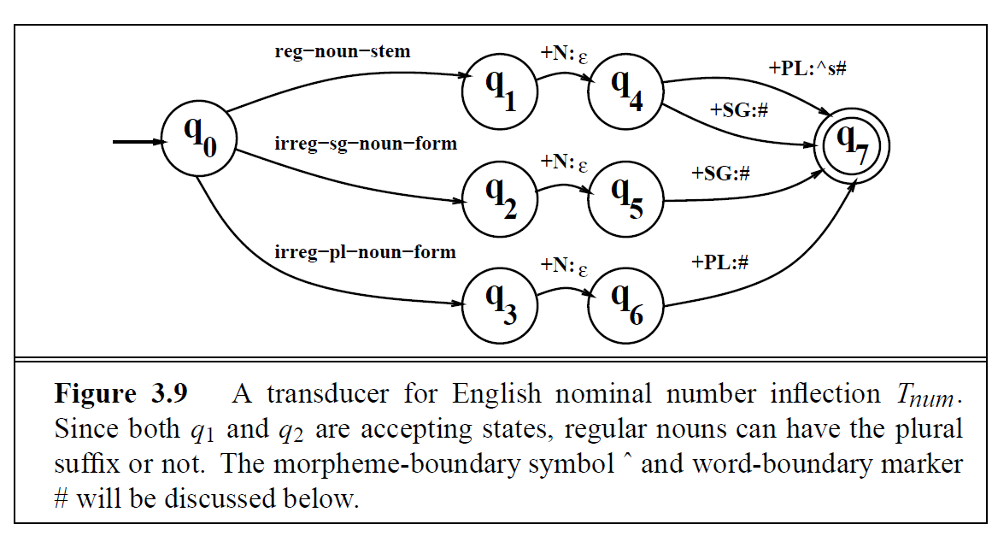


Slide 8
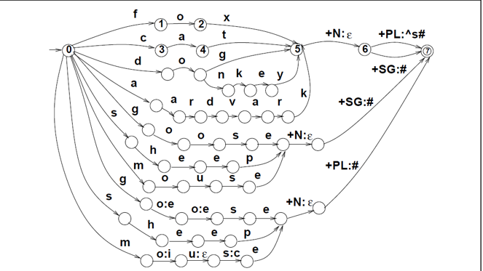

Slide 9
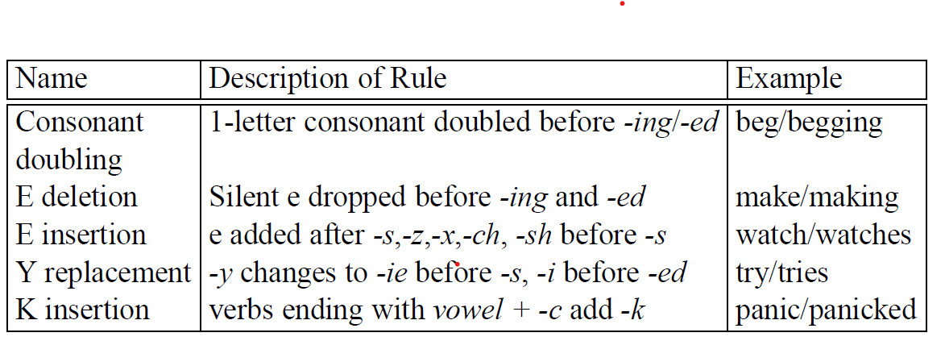

Orthographic Rules and Finite-State Transducers

Slide 10
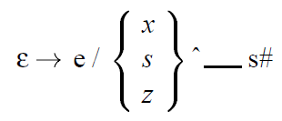

Slide 11
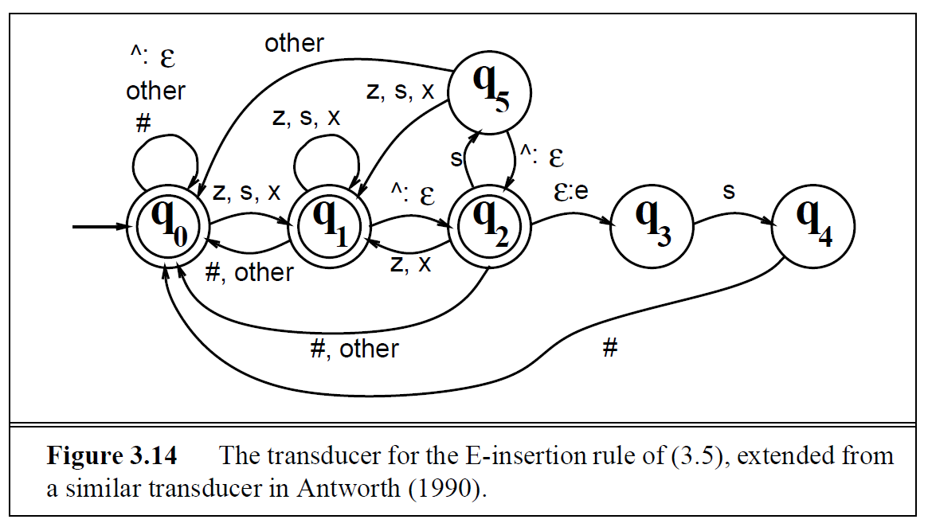

Slide 12
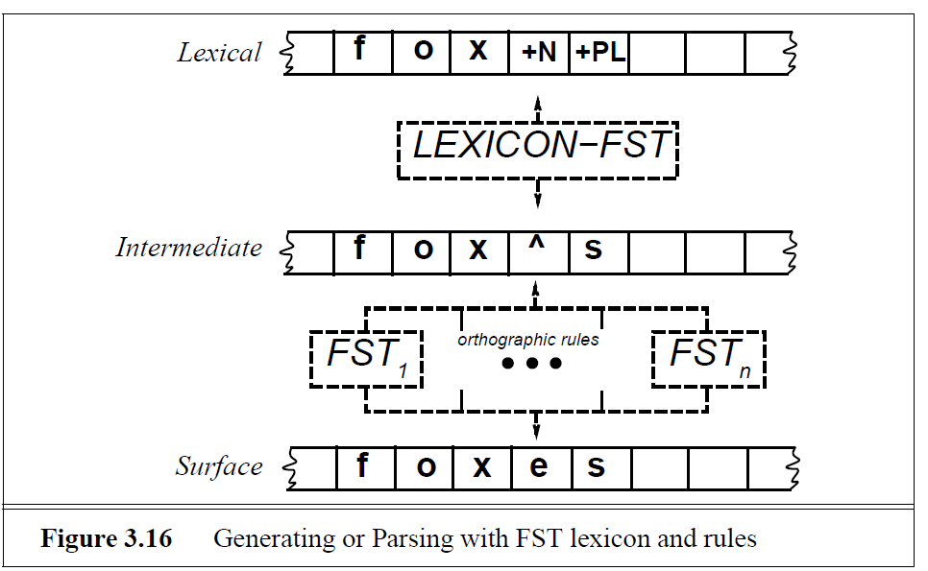
COMBINING FST LEXICON AND RULES

Slide 14
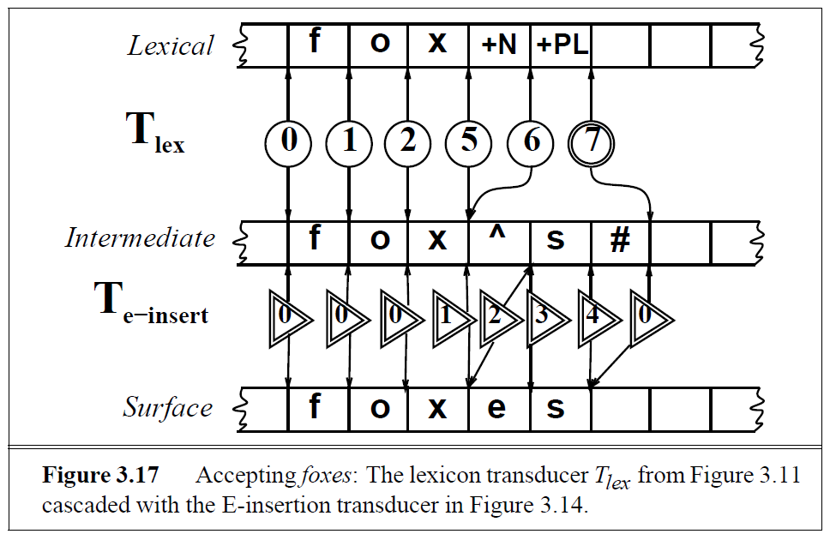

Slide 15
